Slide 1
Sales Forecasting Across Multiple Retail Stores.
Rakesh Devendrasing Pardeshi
Next Hikes IT Solution

Slide 2
Introduction
Objective:
To develop an accurate predictive model that forecasts sales across multiple retail locations using historical data, seasonal patterns,
and external factors.
Tools: The key tools for this project are Pandas, NumPy, scikit-learn, Matplotlib, and Seaborn for data manipulation, modeling, and
visualization, which can be run within a Jupiter Notebook environment.
Techniques Applied:
Applied neural network architectures (e.g., LSTM, GRU, CNN, or DNN) for building robust predictive models capable of learning complex
patterns from large datasets.
Model Serialization:
Used techniques such as Pickle, Joblib, or framework-specific methods (e.g., TensorFlow SavedModel, PyTorch model.save()) to serialize
trained models for deployment and reuse.
MLflow Integration:
Implemented MLflow Tracking for logging experiments, parameters, metrics, and artifacts, and used MLflow Models for model versioning,
packaging, and streamlined deployment.

Slide 3
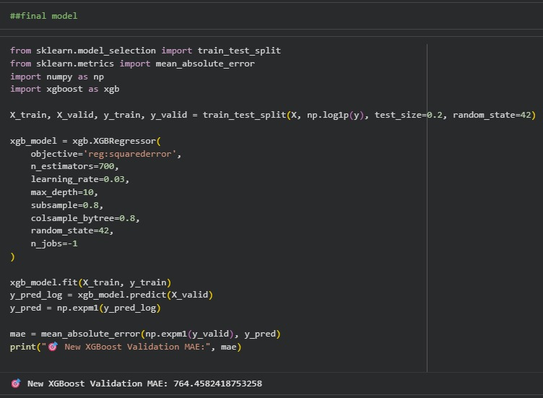
Main Model :

Slide 4
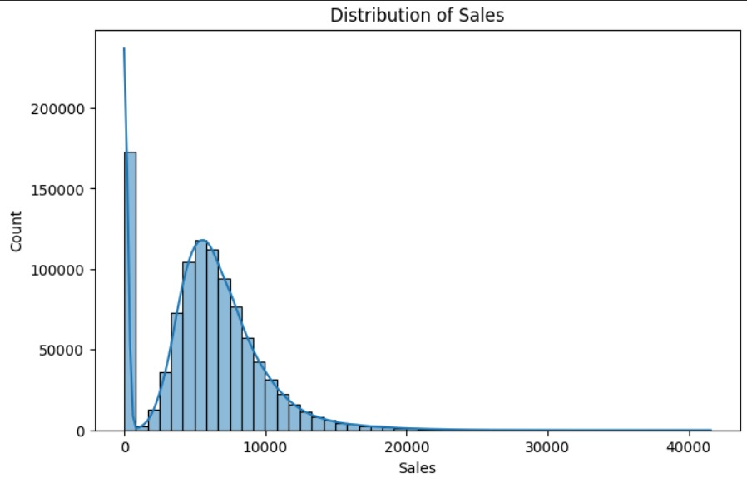
Distribution of sale :

Slide 5
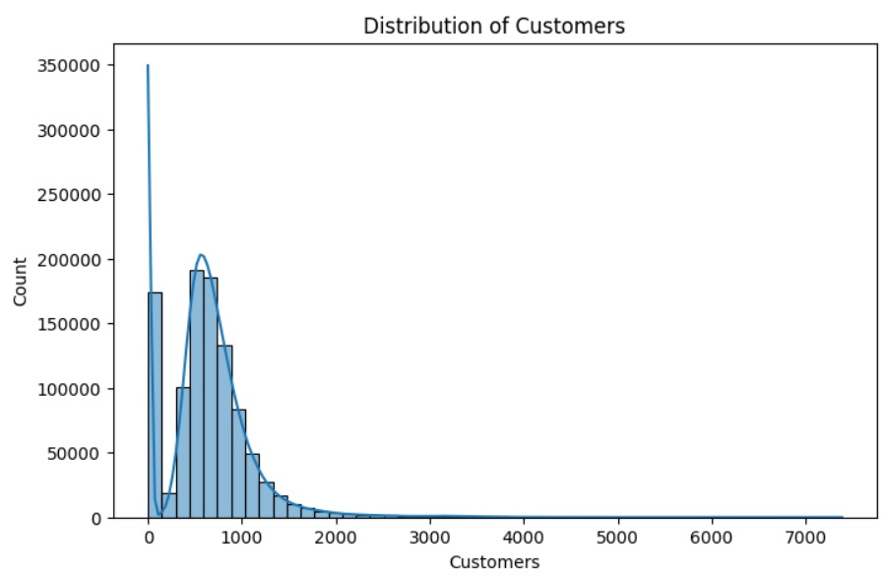
Distribution of customers :

Slide 6
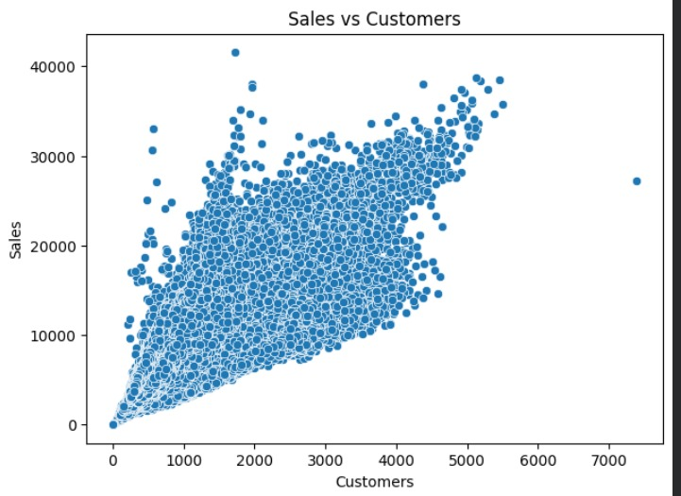
Sales vs Customers :

Slide 7
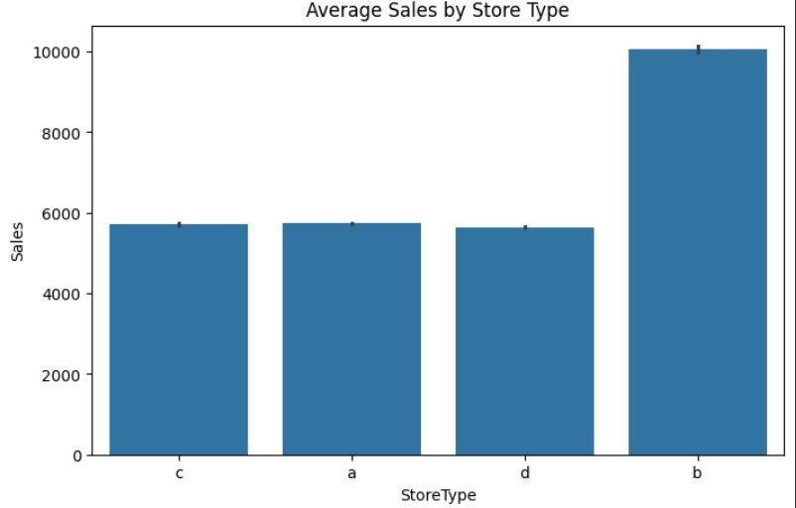
Average Sales by Store Type :

Slide 8
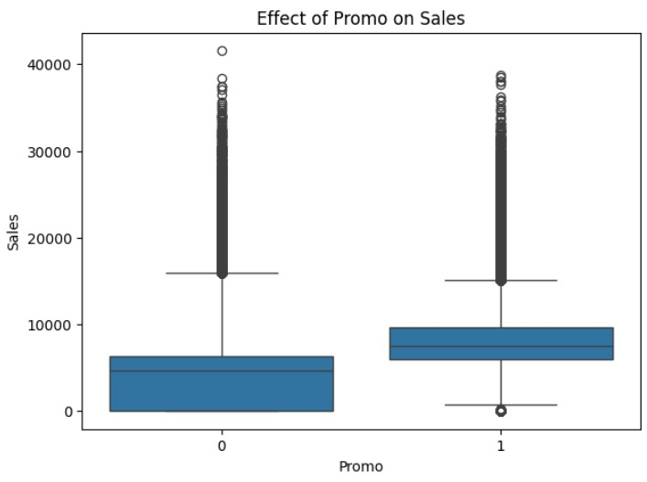
Effect of Promo on Sales :

Slide 9
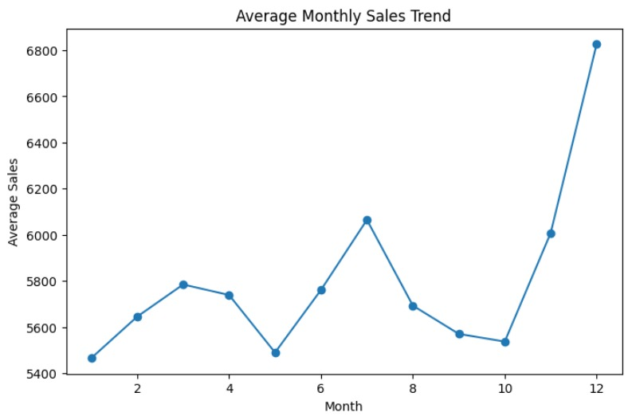
Average Monthly Sales Trend :

Slide 10
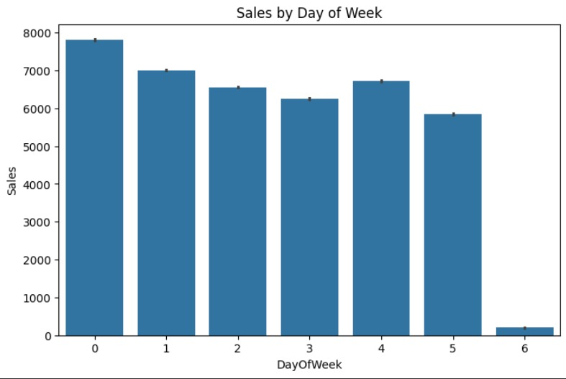
Sales by Day of Week :

Slide 11
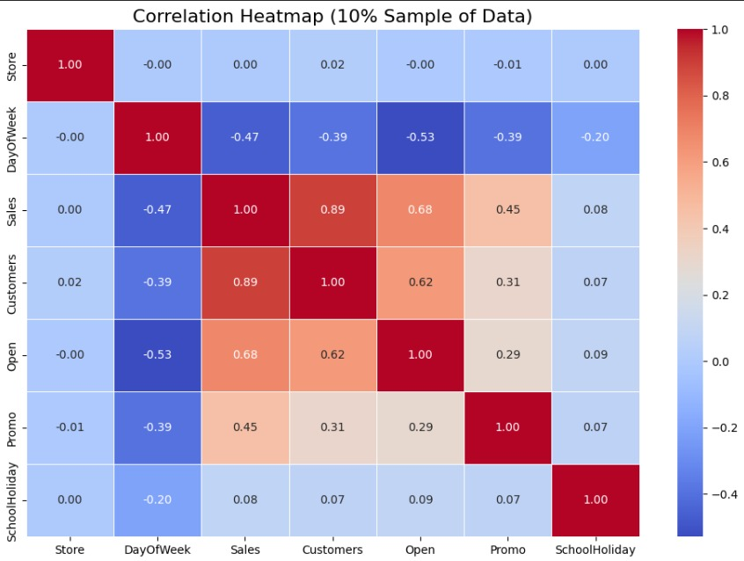
Correlation Heatmap (10% Sample of Data) :

Slide 12
Thank You !

